Slide 1


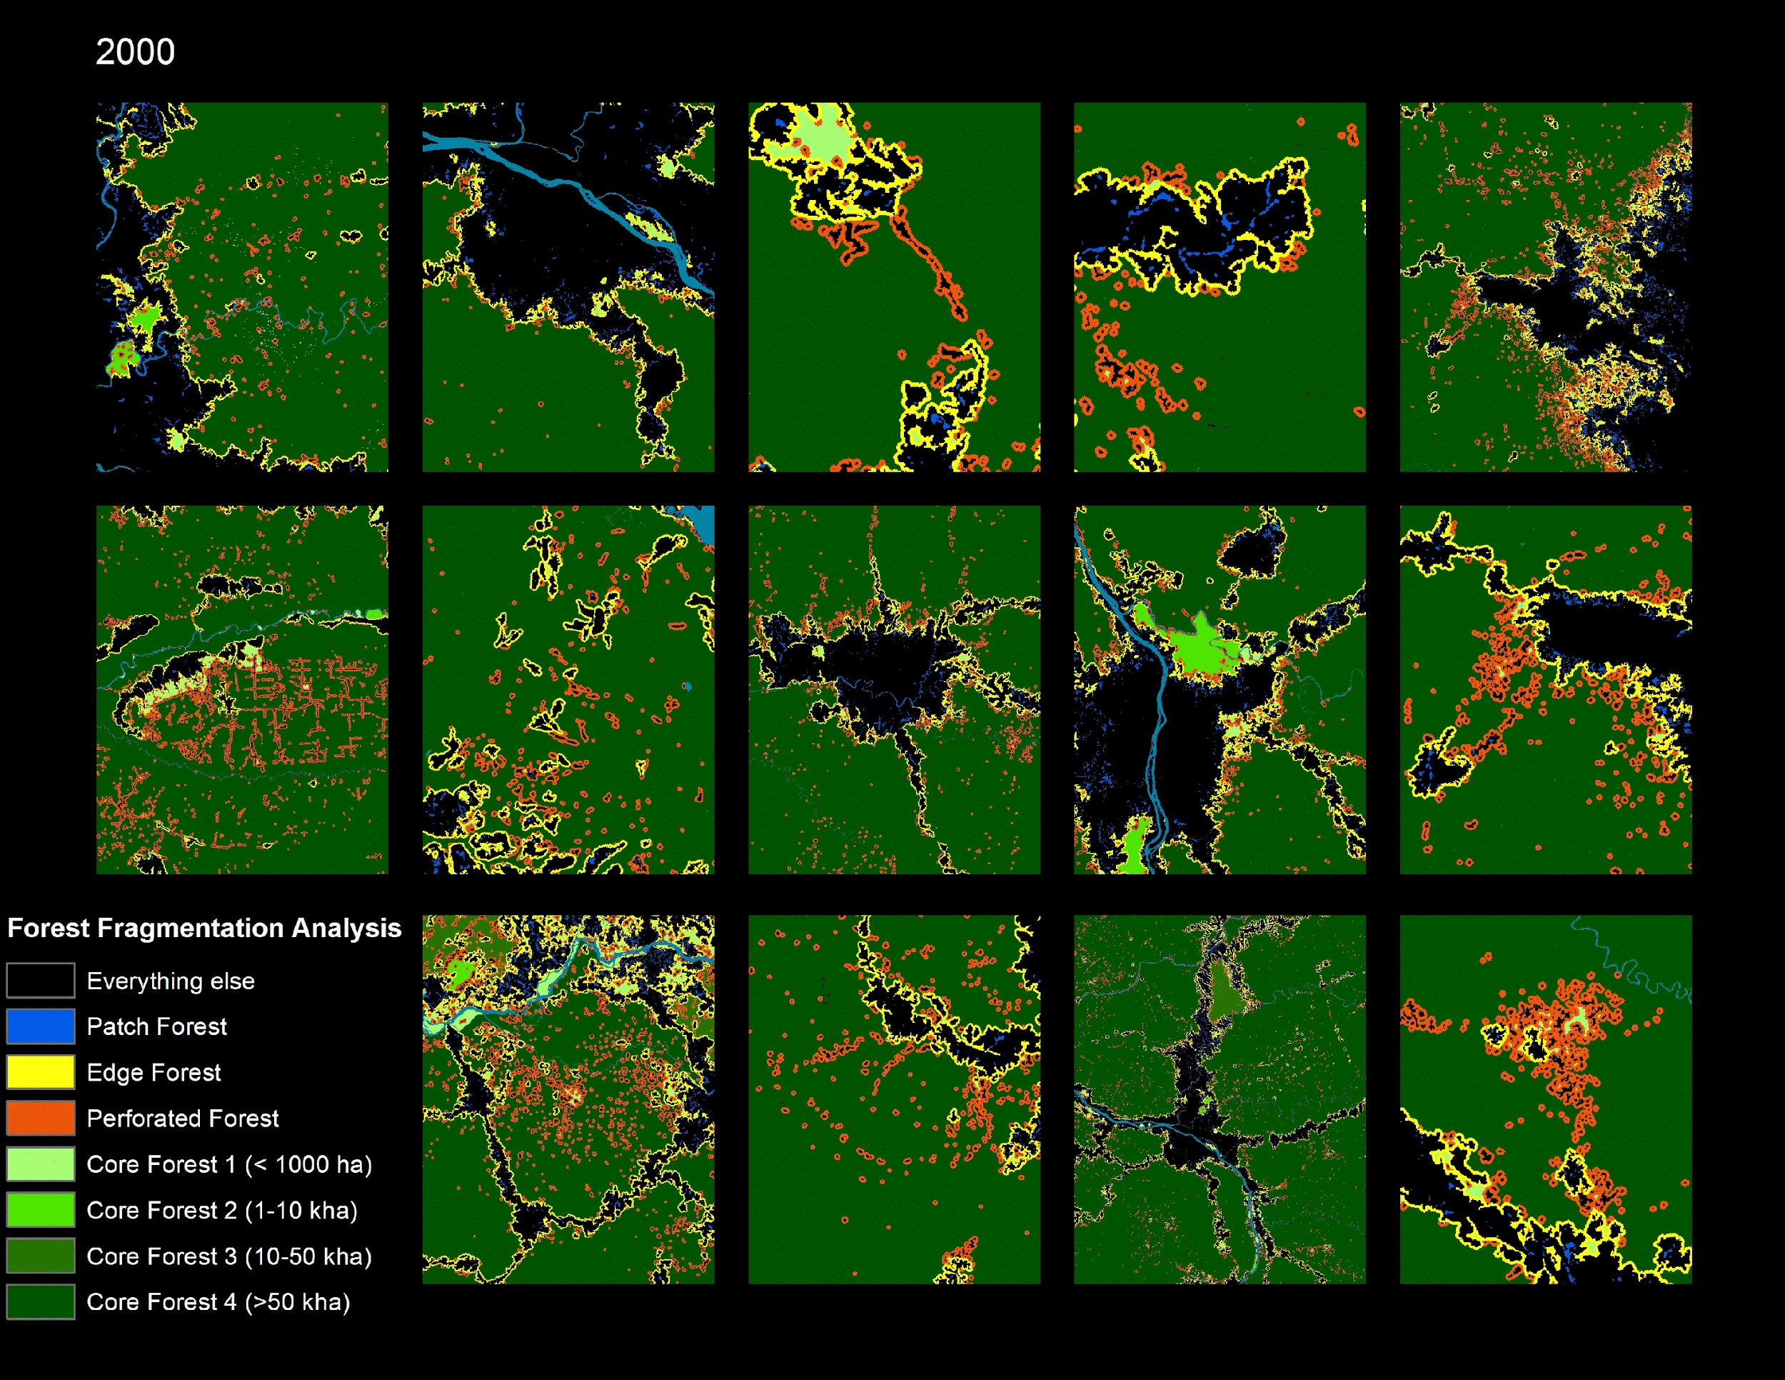
Detection and visualization of Shifting Cultivation
SIH 2020

Slide 2
OUTLINE
Introduction
Objectives
Application
Software Hardware Used
Literature survey
Scope of work
Problem statement
Existing block diagram
Research Gape
Dataset details
Our Work flow
References

Slide 3

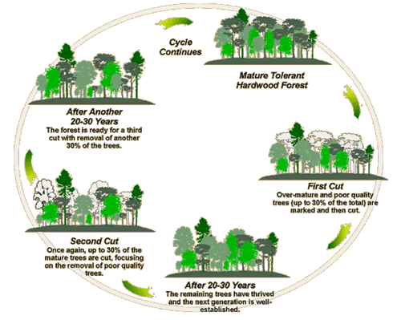
Registration Details
Category : Software
Problem Statement Title : Identify shifting cultivation location in dense temporal stacks
Problem Code : NM395
Mentor : Prof. Sejal Thakkar
Team Members : Ved Suthar (Team Leader)
Parth Desai
Jency Patel
Vrushanki Patel
Dhanvi Acharya
Ayushi Pujara
College Name & Code : IITE – Indus University

Slide 4
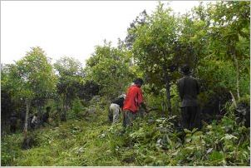
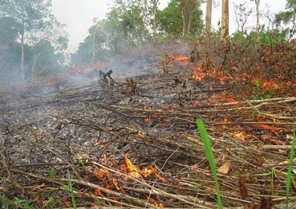
Shifting Cultivation

Slide 5
Problem Description
Shifting cultivation is an agricultural system involving the clearing and burning of natural vegetation, followed by the cultivation of new fields for a few years. This is followed by a period of fallow during which the vegetation regenerates, after which the cycle begins all over again. This is typically followed in the hilly regions of the country. The cycle is likely to be over 7 to 20 years. Using multi-temporal satellite imagery. Develop AI/ML based software/algorithm to map/visualize/analyse
1. Areas exhibiting shifting cultivation.
2. Long-term changes.

Slide 6
Research Work till Date : LITERATURE SURVEY
Here add some latest papers in table form paper name year adv disadv
No | Paper title | Author name | Journal name | Method used | Year | Advantages/Accuracy
1 | Spatio-Temporal Monitoring of Shifting Cultivation Using Landsat Images: Soft Classification Approach | G. Venkata Rao, Anil Kumar, A. Sentil Kumar & M. Shashi | Journal of the Indian Society of Remote Sensing | Soft Classification | 2018 | Mapping and data pre-processing for shifting cultivation

Slide 7
Research Work till Date
2 | Farms or Forests? Understanding and Mapping Shifting Cultivation Using the Case Study of West Garo Hills, India | Amit John Kurien , Sharachchandra Lel and Harini Nagendra | ATREE | MLC algorithm | 2019 | The data is classified using MLC algorithm with 80% accuracy.
3 | Assessment of shifting cultivation fallows in Northeastern India using Landsat imageries | S. V. Pasha, Mukunda D. Behera, S. K. Mahawar, S. K. Barik & S. R. Joshi | International Society for Tropical Ecology | NDVI | 2020 | Accuracy of 84.6% was achieved.

Slide 8
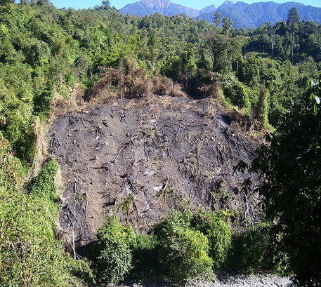
Impact of environment in the district observed during Field Study
1. Shifting cultivation has become unsustainable.
2. Increase in population and pressure on agricultural land has brought huge forest under shifting cultivation.
3. Mass destruction of forest cover leads to deforestation and loss of biodiversity on environment. 130
4. Burning of Jhum is one of the worst impacts on climate as it produce huge junks of smoke and released into the atmosphere.

Slide 9
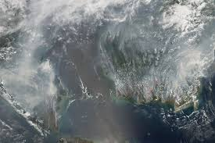
Cont...
5. Rising of a temperature by a few degrees Celsius.
6. Decline in soil fertility with low yield is common in all the ranges.
7. Late monsoon and warm climate.
Using this algorithm and application one can know which places shifting cultivation is being done and can take precautionary steps to prevent the impact on the surrounding environment.

Slide 10

Goal
Collect data from Google Earth Engine.
Pre-process it to suitable, visualizable format so that anyone can visualize it.
Make a software which detects the area exhibiting shifting cultivation.
Make a application which is usable by normal people, who can report recent activities of shifting cultivation.
Collect the reported data and add it to pre-existing model which is made by AI/ML. By doing so the prediction can be very accurate.
Make another algorithm which maps out areas exhibiting shifting cultivation which uses the prediction done by the trained model.

Slide 11
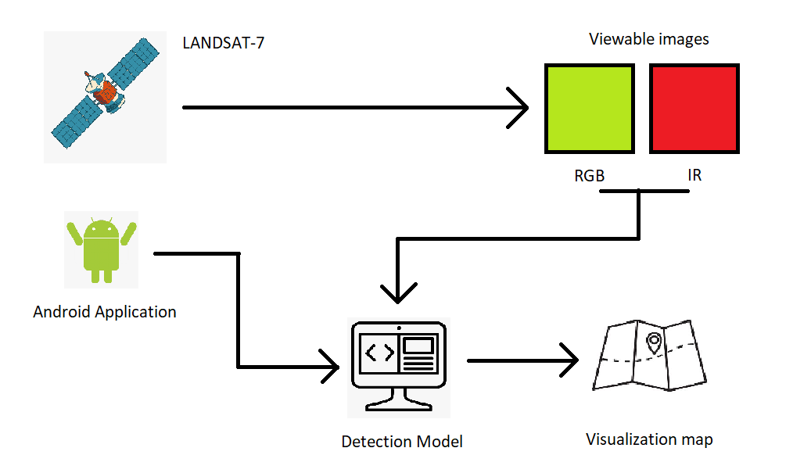
Goal

Slide 12

Approach
Gathering data from LANDSAT-7
Processing data for visualization.
Processing data for changes in vegetation.
Training model
Application for reporting areas (Professional required)
Retraining at specific interval (Reporting required)
Generating map of the classified data by the model

Slide 13

Google Earth Engine
Earth Engine Google Earth Engine combines a multi-petabyte catalog of satellite imagery and geospatial datasets with planetary-scale analysis capabilities and makes it available for scientists, researchers, and developers to detect changes, map trends, and quantify differences on the Earth's surface.

Slide 14
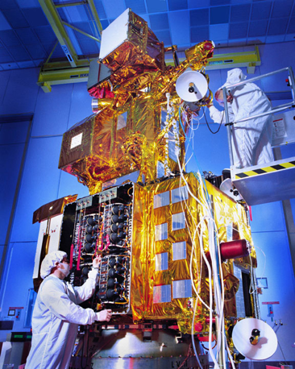
LANDSAT 7
Landsat 7 is the seventh satellite of the Landsat program. Launched on 15 April 1999, Landsat 7's primary goal is to refresh the global archive of satellite photos, providing up-to-date and cloud-free images. The Landsat Program is managed and operated by the United States Geological Survey, and data from Landsat 7 is collected and distributed by the USGS.

Slide 15
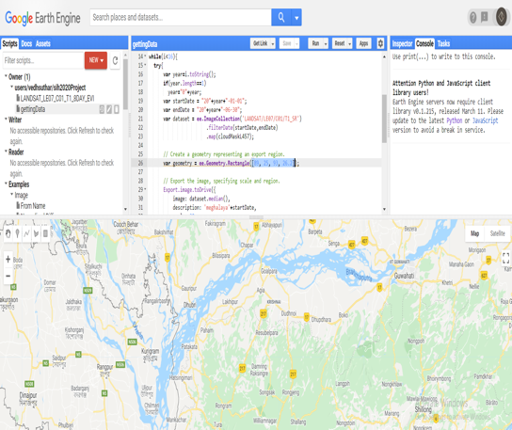
Data Gathering
We first collected raw images from LANDSAT 7.
Region : [89, 25, 93, 26.2]
Data with no cloud-cover.
Interval : 6 months
Date range : From 2000 to 2019

Slide 16
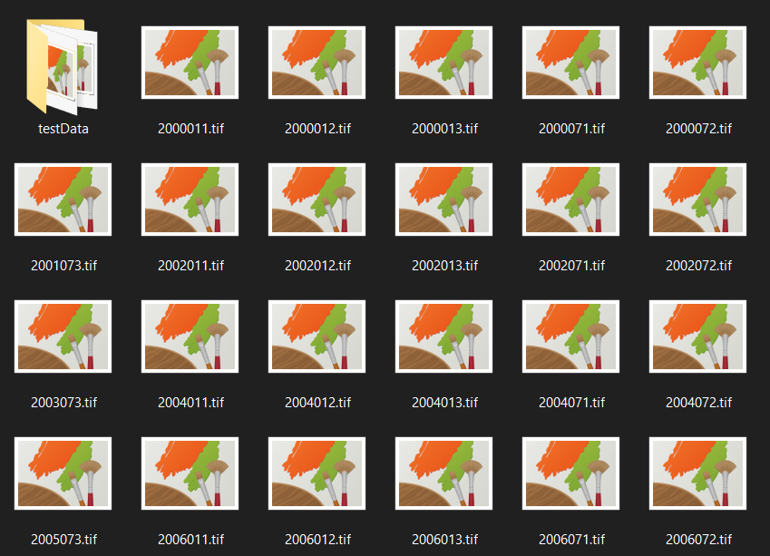
Information about Data
Downloaded and extracted all the data
Data Size : 55.9 GB
Extension : .tif
Bands : 1,2,3 for RGB
Bands : 4,5,7 for IR

Slide 17
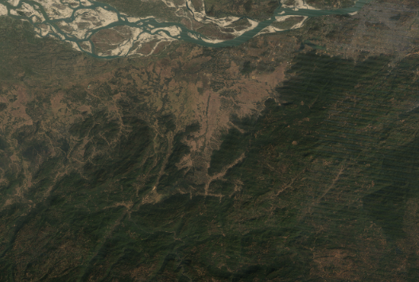
Processing data for changes in Visualization
Processed the raw data to make visualizable images
Bands used
Band 3 Red
Band 2 Green
Band 1 Blue
Band 7 Fake red for IR
Band 5 Fake green for IR
Band 4 Fake blue for IR
Sample RGB image

Slide 18
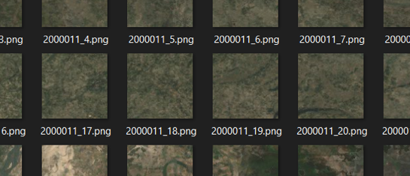
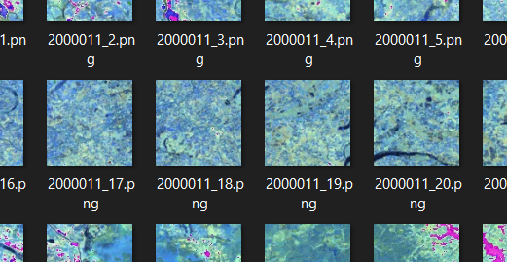
Processing data for changes in Visualization
Processing images to be trainable by a Deep Learning model
Dividing images into 100x100 pixel
Resolution : 30m/pixel
Size : 3km x 3km

Slide 19
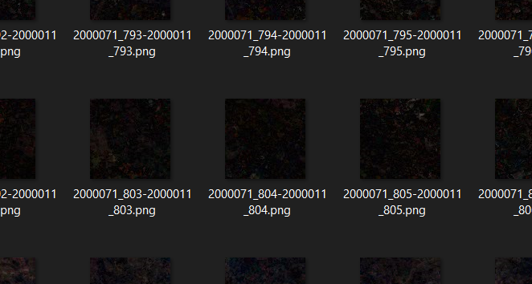
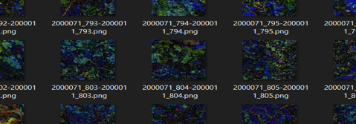
Processing data for changes in Visualization
Found the difference between images of same area but at 6 months of interval.
By this images, we could check if there is a area with spots which could potentially mean that there was a farmland which is not present after 6 months.

Slide 20
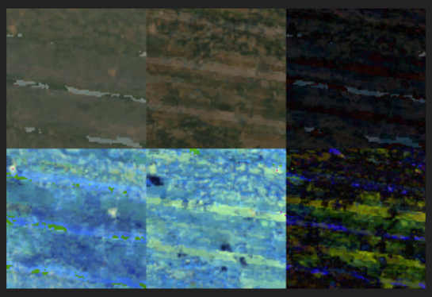
Processing data for changes in Visualization
A program which gives image in six month inerval, with its difference.
[RGB B, RBG A, RGB D]
[IR B, IR A, IR D]
B: Before
A: After
D: Difference

Slide 21
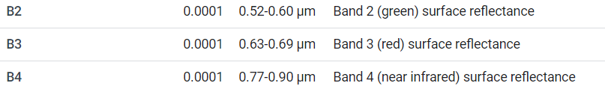
Processing Data for changes in vegetation
Removal of water bodies:
Using ratio for water index Green value/ NIR value
If there is a water body, NDWI > 1

Slide 22
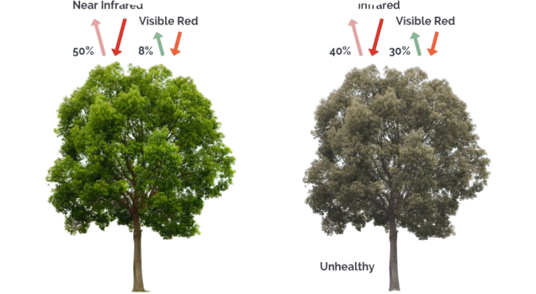
Processing Data for changes in vegetation
Getting the vegetation from the data:
Using modified normalized difference vegetation index
NIR value/(NIR value + Red value)
The resultant value is from [0,1]
Rice is the major crop grown in meghalaya
It’s NDVI is from 0.4 to 0.9

Slide 23
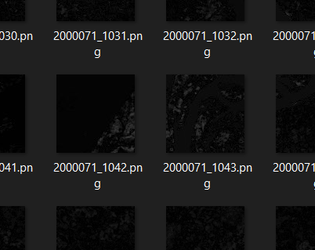
Processing data for changes in Visualization
Difference and dealing with noise and error reduction:
Using mean value of the processed image, we got minimum difference in change of vegetation in 6 months.
Furthur using the mean value of the change, we calculated variance to identify the change in the difference of ndvi.

Slide 24
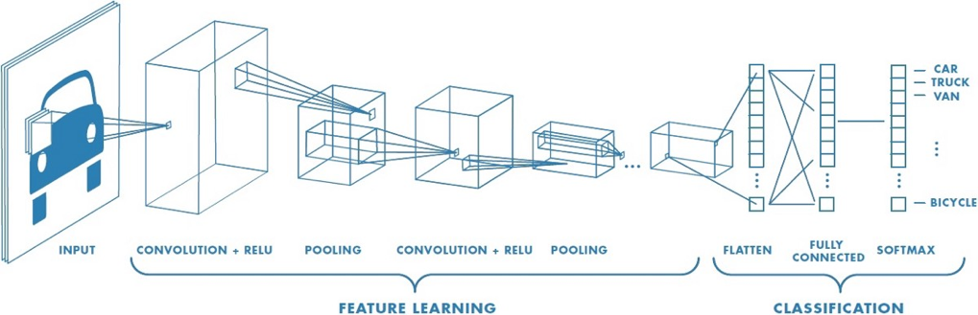
Technology used for training [CNN]
In neural networks, Convolutional neural network (ConvNets or CNNs) is one of the main categories to do images recognition, images classifications. Objects detections, recognition faces etc, are some of the areas where CNNs are widely used.

Slide 25
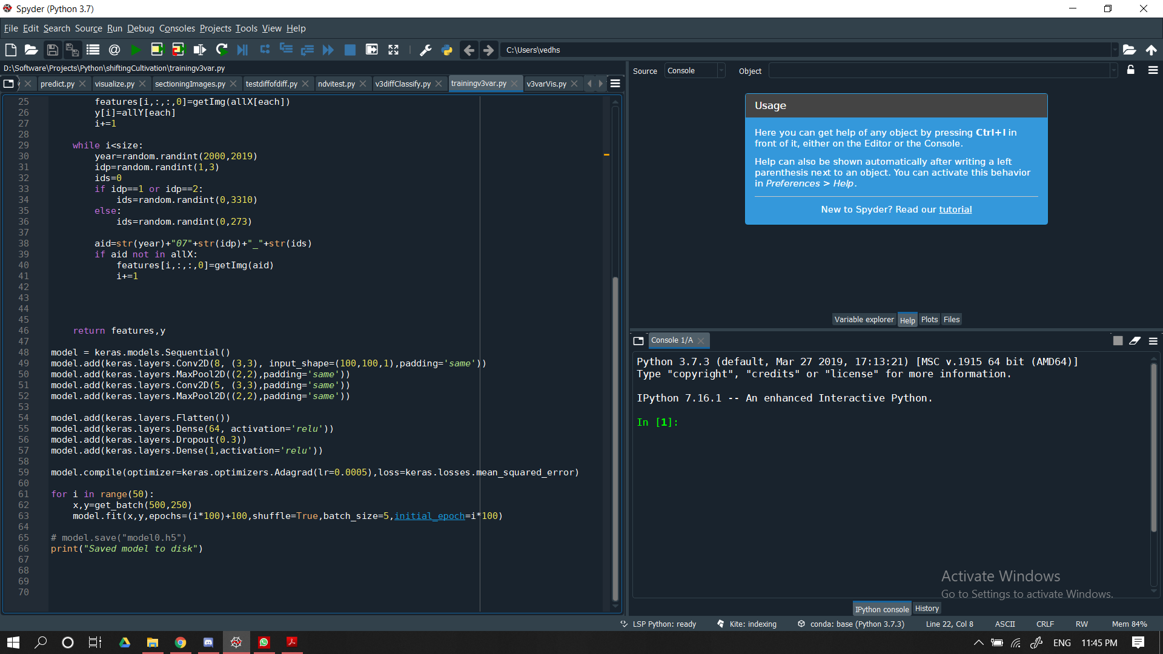
Model Training
As we have the required inputs and required outputs, we started model training.
For input: Variance of difference of NDVI image
Output: Area of change in vegetation cover

Slide 26
Model Training
As there was huge data, around 250k images. Batch execution was done.
We seperated training and testing data.
From training data, we got a batch with 250 images where shifting cultivation was done and 250 without it.
We formed 50 random batches and trained the model over it.
Training accuracy: MSE of 9-11
Test set accuracy: MFE of 10-14
Note*: This accuracy is on the first batch, once the accurate data is reported, accuracy can increase.

Slide 27
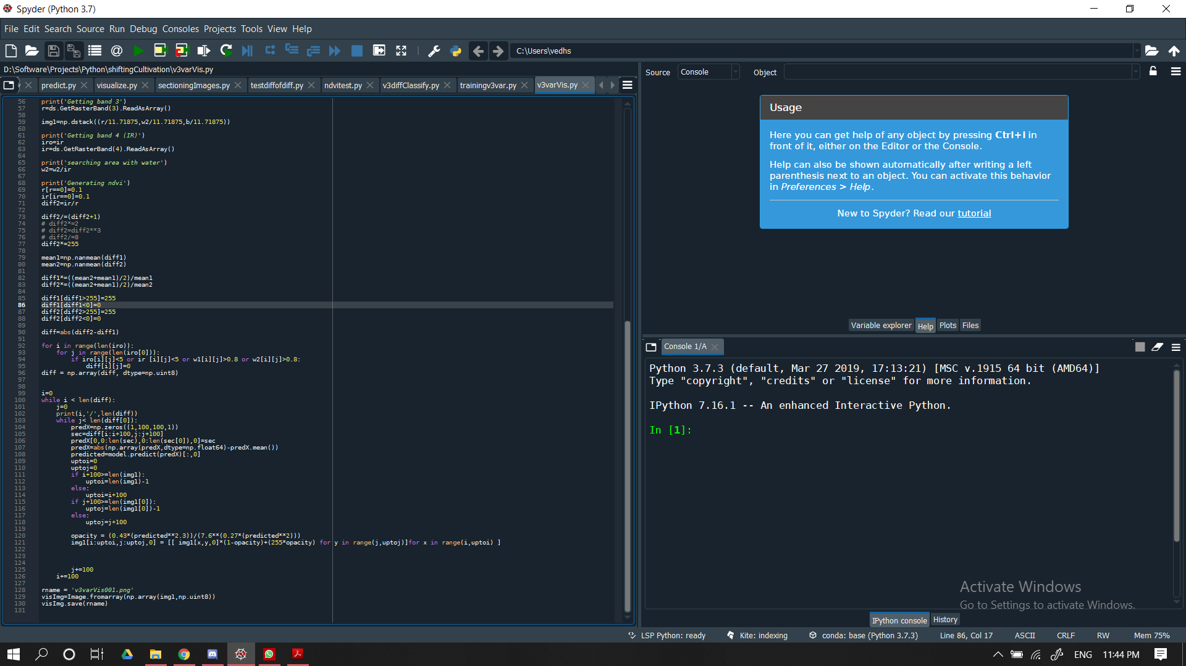
Mapping and visualization
Once the model is trained, we could predict it and map it back onto the RGB image from the LANDSAT-7. From our research, the average size of farm in meghalaya is 2100 sq. m.
So when a single farm is shifted, there would be average change of this much area.
From the predicted value of area changed by the CNN model, we could visualize different area.

Slide 28
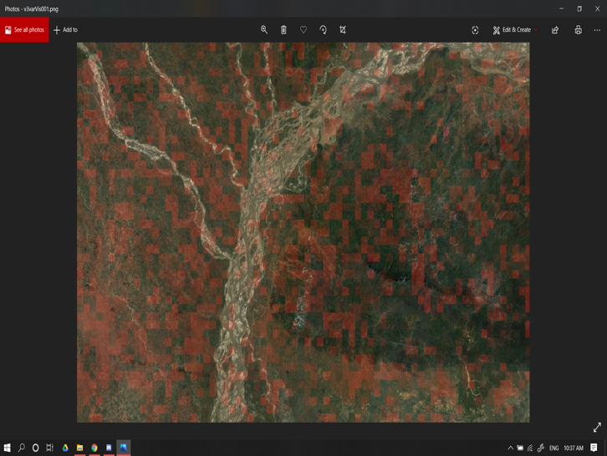
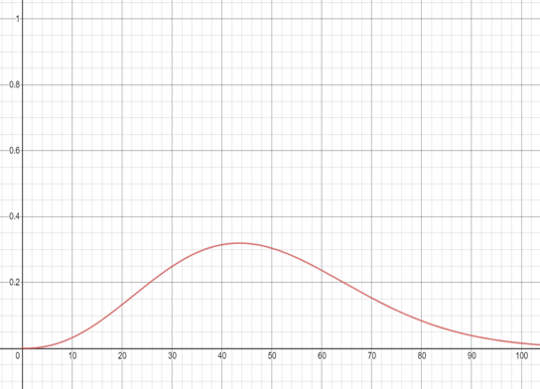
Visualization
Mapping of the output
Curve used for generating image

Slide 29
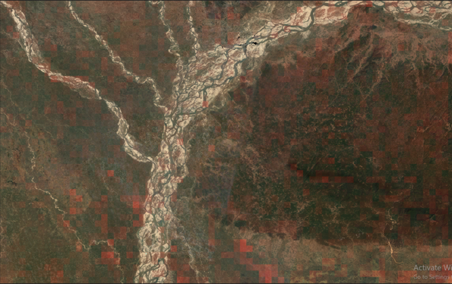
Using multi-temporal data
Used the prediction of model from 8 years of data.
If there is a yearly periodic pattern of agriculture,
variance(change in vegetation)=0
Over the 8 years.

Slide 30
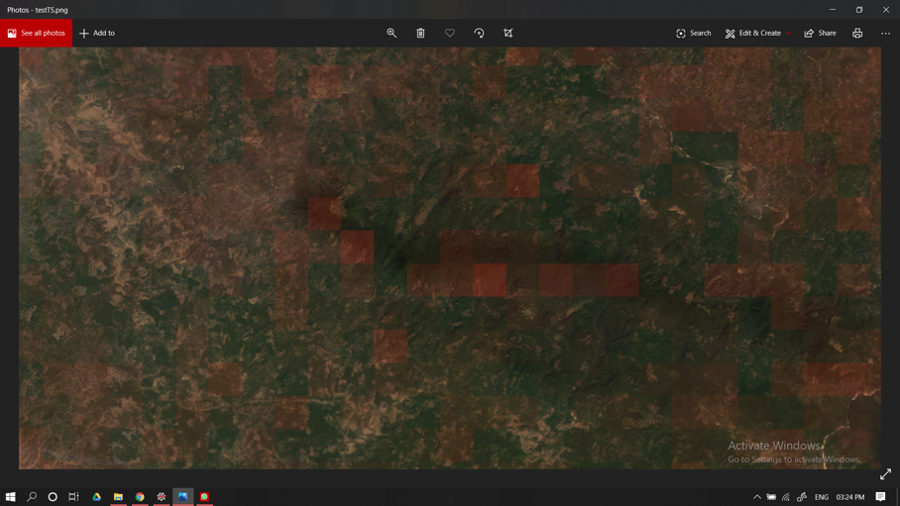
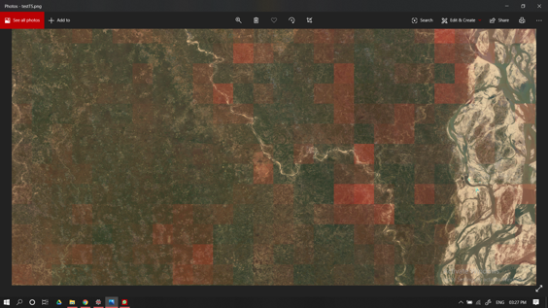
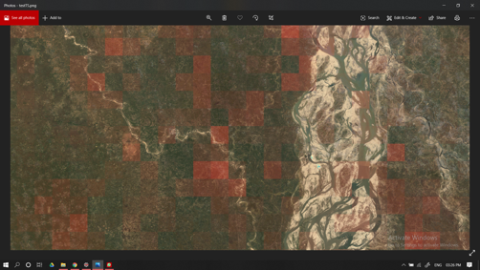
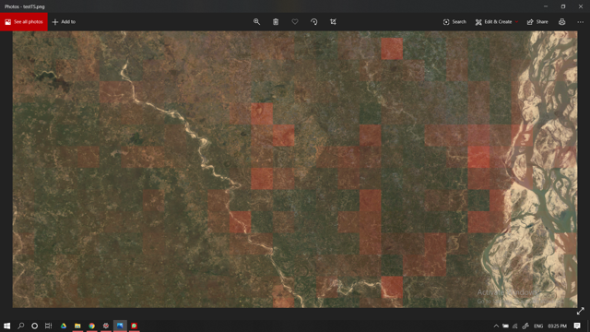
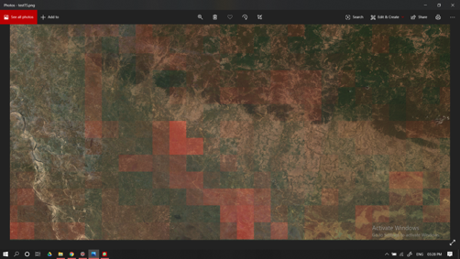
Cont.

Slide 31
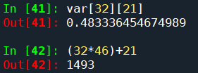
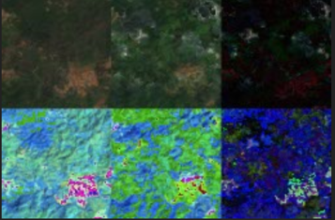
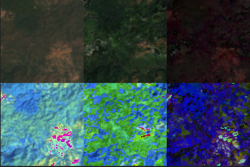
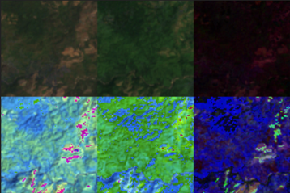
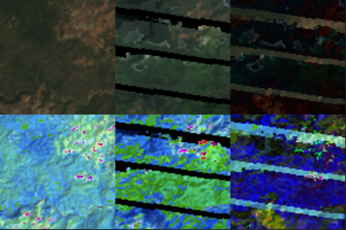
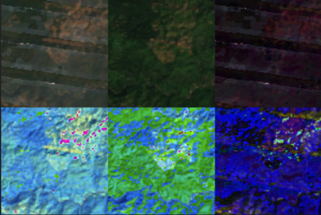
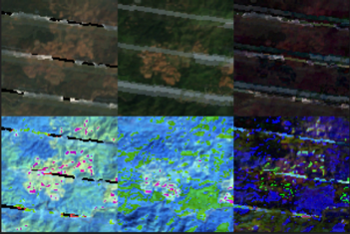
Checking the prediction [1]

Slide 32
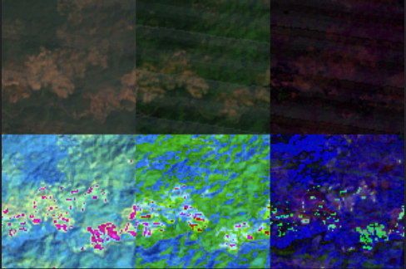
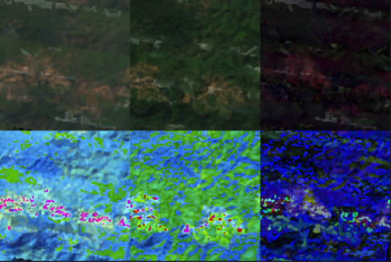
Checking the prediction [1]

Slide 33
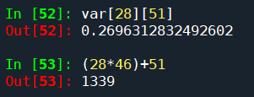
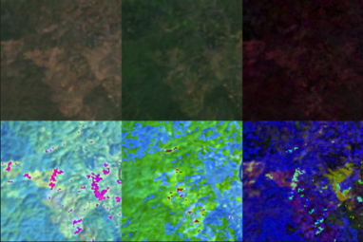
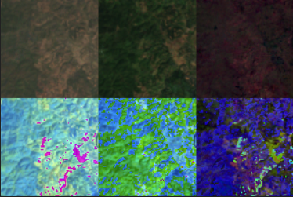
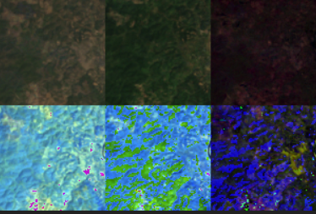
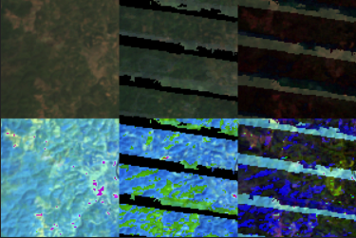
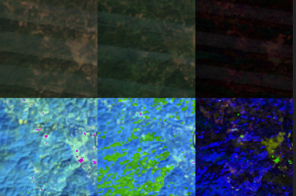
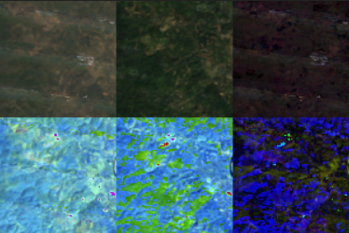
Checking the prediction [2]

Slide 34
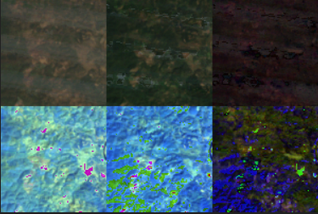
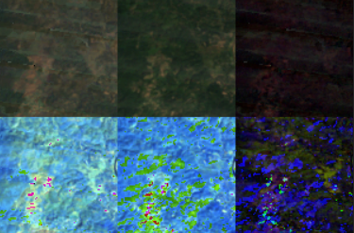
Checking the prediction [2]

Slide 35
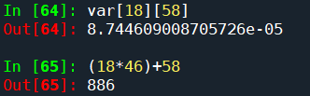
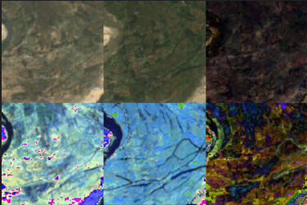





Checking the prediction [3]

Slide 36


Checking the prediction [3]

Slide 37







Checking the prediction [4]

Slide 38


Checking the prediction [4]

Slide 39

Classification of different areas
We used the NDVI value and the Burn index to classify the land cover.
Output classes
Barren Land
Crop/Vegetation
Forest
Burnt vegetation
Other

Slide 40


Visualization of the result

Slide 41


Multi-temporal analysis

Slide 42

Android Application
A application where user can report the area exhibiting shifting cultivation.
This data can be used so that our data can be classified with higher accuracy.
Retraining the model within regular interval with the new reported data.

Slide 43



Android application

Slide 44
Changes done on the base of comments
Used the data of 8 years from the LANDSAT-7 to differentiate between regular cultivation and the shifting cultivation.
Generated new model to classify land areas.
Support to view photo of a particular area on the android while reporting.
Analysis of the data from multiple years.

Slide 45
Bibliography
Effects on LANDSAT images: Spatio-Temporal Monitoring of Shifting Cultivation Using Landsat Images: Soft Classification Approach
Vegetation constant : Mapping Rice Cropping Systems in Vietnam Using an NDVI-Based Time-Series Similarity Measurement Based on DTW Distance
Water bodies detection : Identification of Water Bodies in a Landsat 8 OLI Image Using a J48 Decision Tree
Crop study of meghalaya: https://en.wikipedia.org/wiki/Meghalaya#:~:text=Meghalaya%20has%20predominantly%20an%20agrarian,%2C%20papayas%2C%20spices%2C%20etc.
Size of farms: https://www.zizira.com/blogs/people-and-process/farmers-leaving-farming-in-meghalaya#:~:text=Is%20there%20a%20criterion%3F,in%20Meghalaya%20is%200.21%20hectare.

Slide 46

conti.....

Slide 47
Thank You...!!

